Slide 1
caArray User Community Meeting
2.1.0 and caRPLA overview
Call in: 877-416-5524
Participant Passcode: 2627056
Centra: http://ncicb.centra.com
Meeting ID: array_july2
July 2, 2008

Slide 2
Agenda
Current release
2.1.0 release update
Molecular Analysis Knowledge Center introduction
caRPLA overview – Gerald Fontenay, LBNL

Slide 3
Current release: 2.0.2
2.0.2 installer and upgrade installer are available at http://gforge.nci.nih.gov/frs/?group_id=305
2.0.2 Patch 1 is currently on https://array.nci.nih.gov
  Performance enhancements for page loading
  Will be available to local installers with 2.1.0 release
SNP and transcript profiling data made publicly available by GlaxoSmithKline is hosted in caArray
  https://array.nci.nih.gov/caarray/project/woost-00035
  https://array.nci.nih.gov/caarray/project/woost-00041
Multiple datasets from TCGA now available
caBIG™ Annual Meeting Hack-a-Thon materials are available at http://gforge.nci.nih.gov/docman/view.php/305/12821/caarray_hackathon_2008.zip

Slide 4
2.1.0 Release Update
Schedule: Release date has been set to July 31 – delayed from original date due to 2.0.2 release.
Scope will include open defects plus additional functionality
Query Defect Tracker and Feature Request Tracker for target_release=2.1.0 for detailed visibility into current scope
  Defects:
  http://gforge.nci.nih.gov/tracker/?atid=1344&group_id=305&func=browse
  Feature requests:
  http://gforge.nci.nih.gov/tracker/?atid=1273&group_id=305&func=browse

Slide 5
2.0.1 Scope
In scope
  [#15021] Implement GridTransfer support for acquiring file data via Grid API
  [#12252] Provide a mechanism to allow array data files to be associated with pre-populated annotations
  [#10115] Ability to delete Experiments
  [#11751] Allow unzip of nested zip files for import
  [#13332] Draft Experiments should have No Visibility
  [#11716] Allow viewing / editing of multiple protocol applications for Biomaterials
  [#14770] PMRP - Provide a well-known URL to navigate to a Sample page
  [#11925] Support PGF and CLF files for Affymetrix array design import (necessary for Exon arrays)
    This feature is borderline for the release – may require a minor/patch release
Deferred to 2.2
  Ability to query other caArray Grid instances (initial implementation)
  caGrid security

Slide 6
Upcoming Features
Sample-based search results
Improvements to service interfaces
Upload/download client

Slide 7
Molecular Analysis Knowledge Center
Awarded to Columbia University and The Broad Institute
Will provide user support for the following systems
  caArray
  caIntegrator
  geWorkbench
  GenePattern
Activities will include
  Monitoring a defect and feature request tracking system for community input
  Monitoring a user forum (akin to our current caArray Users listserv)
  Creating over time a wiki-based Knowledge Base for the organization and retrieval of solutions to issues (scientific and technical) encountered by end-users
  Enhancing the documentation for each tool

Slide 8
caRPLA Overview

Slide 9
caRPLA and caArray2
Gerald Fontenay
Paul Spellman
LBNL
2008/07/02

Slide 10
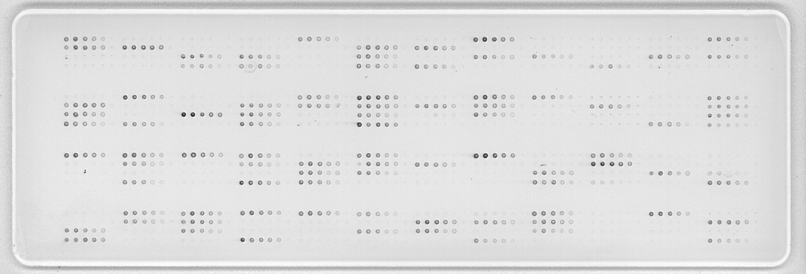
Reverse-Phase Protein Lysate Array
“Reverse” model:
Measures expression levels of one protein in many samples

Slide 11
RPLArrays:
Workflow
Biological samples
Printed on RPLArray in serial dilutions
RPLAHybridization: Antibodies/enzymes applied
Slide scanned using MicroVigene software
SuperCurve R package from M.D. Anderson
Estimated protein concentration for each sample

Slide 12
Broad Goals of caRPLA
Support RPLA data management by leveraging caArray2 software
Microarray data and RPLA data to reside in same system and use same modeling where appropriate
All caArray2 functionality to remain intact

Slide 13
Approach
The MAGE-TAB data exchange standard is extended to support:
  Annotation of antibodies
  “Reverse” array model layout
The caArray2 data management system is extended to support:
  Parsing, validation, and import of an RPLA-TAB dataset
  Data and annotation management for antibodies and RPLAs

Slide 14
RPLA-TAB Dataset Design and Parser
IDF -> RPLAIDF
Antibody section
Antibody Name
Antibody Target Gene Name
Antibody Target Gene Name Term Source REF
Antibody Specificity
Antibody Epitope
Antibody Immunogen
Antibody Provider
Antibody Catalog ID
Antibody Lot ID
Antibody Comment
RplArray Name
RPLArray Name
RPLArray Comment
Dilution Section
Dilution
Dilution Value
Dilution Unit
Dilution Unit Term Source REF
SDRF -> SRADF
Samples Section
[ sourceHeaders() (protocolHeaders())* ]
sampleHeaders()
( (protocolHeaders())* sampleHeaders() )*
(factorValueHeaders())*
Array Section
arrayRef() featureLocation() sampleRef() dilution()
Array Data Section
arrayRef() antibodyRef() (protocolHeaders())*
assayName()
(protocolHeaders())* [imageFile()]
(protocolHeaders())* [arrayDataFile()]
( (protocolHeaders())* derivedArrayDataFile() )*
( factorValueHeaders())*
* : 0 or more
[ ] : Optional

Slide 15
Project Status
To date:
  Modeling and use cases
  Dataset format design and parser
  Prototype that validates and imports an RPLA-TAB dataset through caArray2 web interface/infrastructure
    Prototype tested using battery of valid and invalid RPLA-TAB datasets (available through SVN)
    Validation error reporting system is reused
    Informative validation messages are provided to the user
In progress:
  Completing the web interface and finalizing the modeling
  Grid service

Slide 16
Modeling
https://gforge.nci.nih.gov/svnroot/caarray2/branches/caRPLA/docs/EAP/caRPLA_modified_caArray_v2.EAP

Slide 17
caArray2 codebase:
Current reuse and modifications
Able to use EJB and Struts2 framework (Best practices already throughout)
Relatively few changes to existing classes:
  Added new AssayType: RPLA
  Changes allowing import of RPLA-TAB files
  Accommodation of different class heirarchies ( mostly because of ArrayDesign exclusion)
  Removing final
Infrastructure class reuse examples:
  Classes in gov.nih.nci.caarray.validation, especially ValidationResult
  Classes in gov.nih.nci.caarray.magetab
Domain class reuse:
  Used and/or extended all domain classes (except for ArrayDesign-related classes)
  Some examples :
    gov.nih.nci.caarray.domain.vocabulary: Term, TermSource, and Category
    gov.nih.nci.caarray.domain.sample.* ( minus *Extract classes )
    gov.nih.nci.caarray.domain.file: CaArrayFileSet, and FileStatus
Used as working examples:
  Importer and Translation subsystem design: MAGE-TAB documents to Domain classes
    e.g., MageTabImporter -> RplaTabImporter and SdrfTranslator -> SradfTranslator

Slide 18
Thanks
caArray Development Team
Juli Klemm and Eric Tavela
Doris Siwak (MDA) and Heidi Feiler(LBNL)

Slide 19
Some ideas for possible discussion
Local streaming Java applet that allows browsing of local file system and skips need for zip
Would some parsing/validation on client-side be useful?
Integration of a standalone file (and image) server for immutable data files
Server borrowed from NIH/MIT Open Microscopy Project (OME)
High-performance app. in C available through http (Apache CGI)
Support and API for Files and 5D (x,y,z,c,t) Pixels stacks
http://www.openmicroscopy.org/api/omeis
Local port to PostgreSQL:
Devel., admin., and maintenance of pgSQL databases in place onsite + pgSQL port =
Easier adoption and integration with other local systems Hibernate helps * a whole lot *
Significant advantage: PL/R
Very simple use of Java TreeView applet to display prepared clustered data files
Locally we have been modifying JTV source code:
Dual matrices, linear color scaling, and signed applets over HTTPS

Slide 20
Mechanisms for Feedback
caArray Users listserv
  We welcome and encourage active exchanges on this listserv to share experiences with the product
Community Change Request tracker
  http://gforge.nci.nih.gov/tracker/?atid=1339&group_id=305&func=browse
This meeting
Next Meeting:
Wednesday, August 6, 2:00 PM ET

